Slide 1



Machine Learning Approach for Personalized Mood Detection on Spotify
DATA MINERS

Slide 2

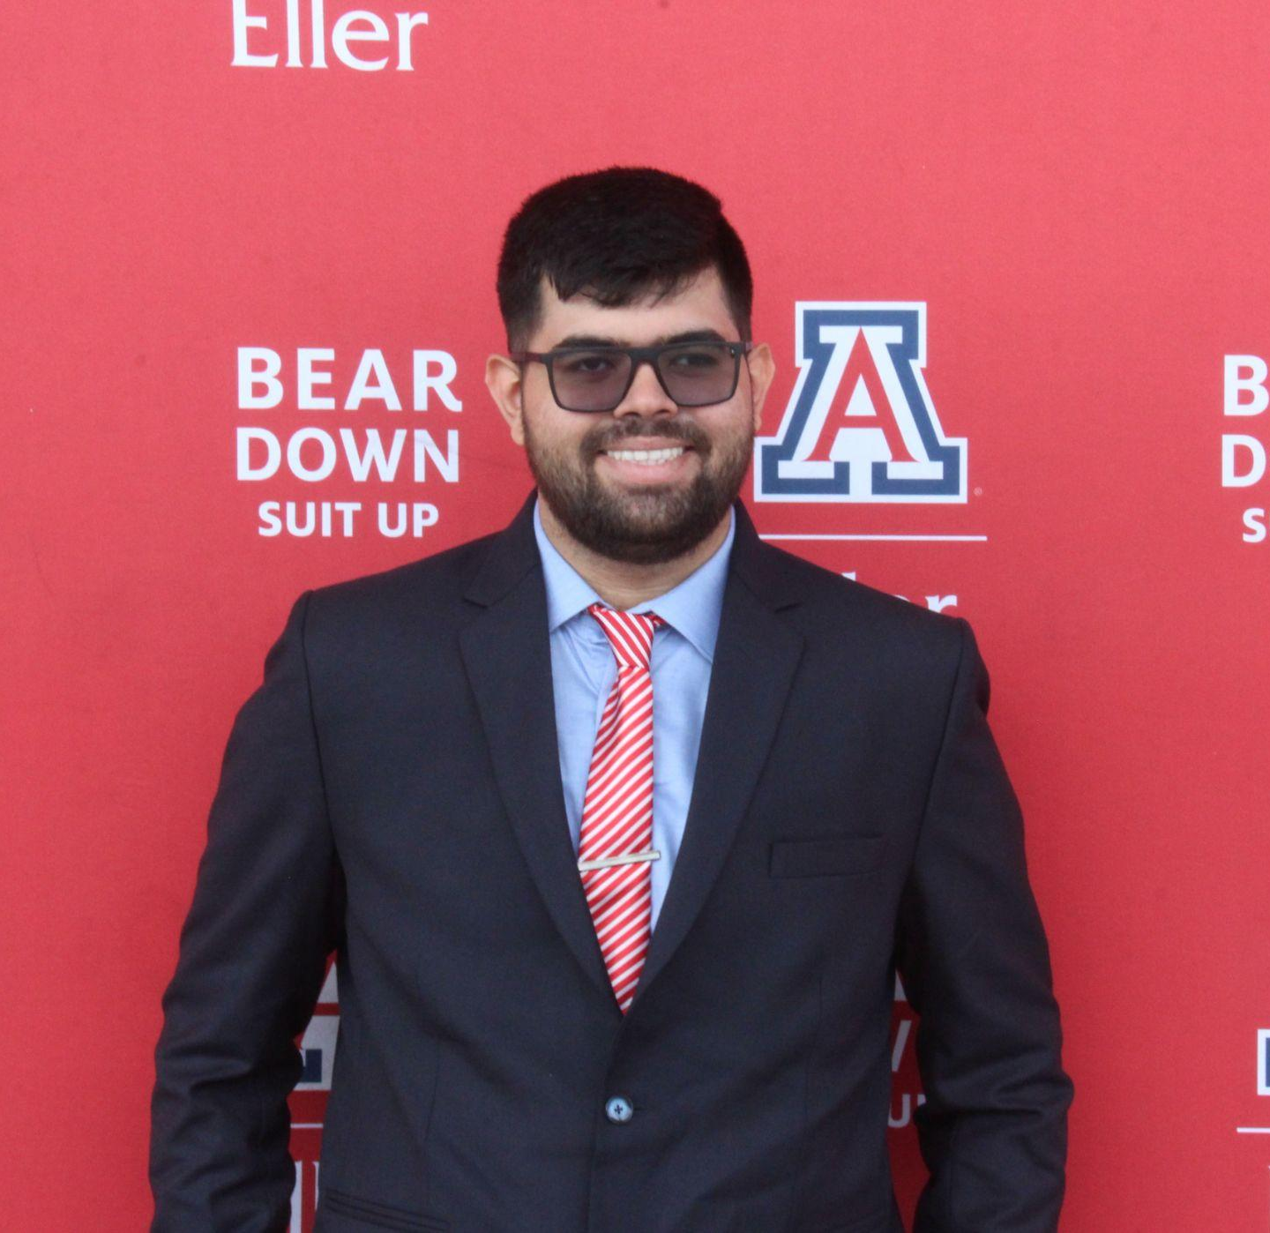


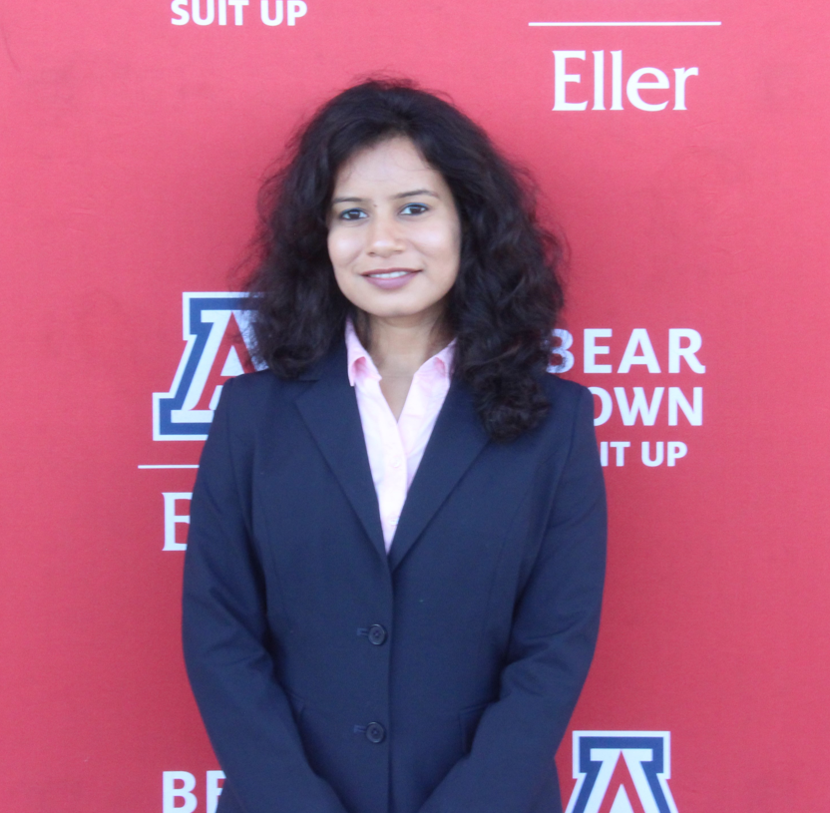
OUR TEAM
Rohan Pudipeddi
Utsav Parekh
Minita Joshee
Priyal Dani
Tanya Sharma

Slide 3
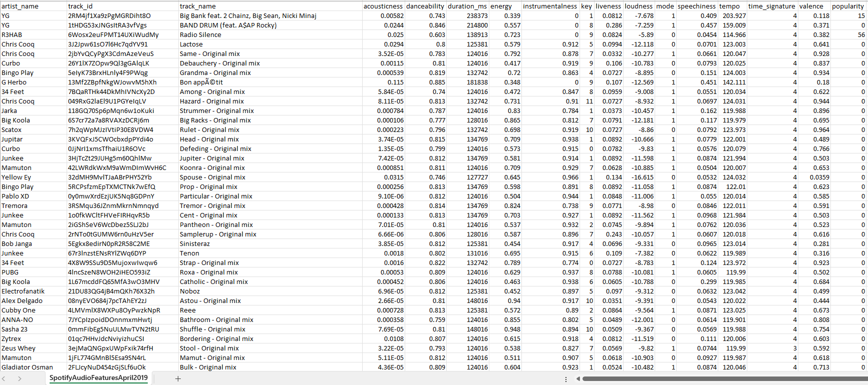
DATASET OVERVIEW
TOTAL RECORDS
130,663
TOTAL FEATURES
17

Slide 4

FEATURE EXPLANATION
artist_name: The name of the track's artist
track_id: A unique identifier for the track
track_name: The title of the track
acousticness: Measure of acoustic characteristics (0 to 1)
danceability: Indicates suitability for dancing (0 to 1)
duration_ms: Duration of the track in milliseconds
energy: Perceptual measure of intensity and activity (0 to 1)
instrumentalness: Predicts whether the track is instrumental (0 to 1)
key: The key the track is in (numeric representation)
liveness: Detects the presence of an audience (0 to 1)
loudness: Overall loudness of the track in decibels (dB)
mode: Modality of the track (Major = 1, Minor = 0)
speechiness: Presence of spoken words (0 to 1)
tempo: Estimated tempo of the track in BPM
time_signature: Estimated overall time signature of the track
valence: Musical positiveness of the track (0 to 1)
popularity: Metric indicating the track's popularity

Slide 5
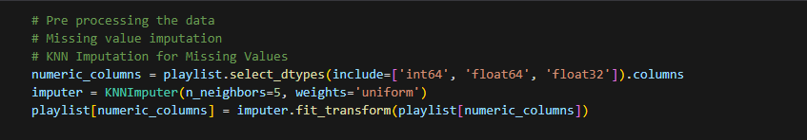

DATA PREPROCESSING
Handling missing values using KNN imputation
Normalizing numeric features using Min-Max scaling

Slide 6

DIMENSIONALITY REDUCTION USING t-SNE (t-DISTRIBUTED STOCHASTIC DISTRIBUTION)
What?
How?
Why?
Reduce the dimensions of the dataset
Transforms high-dimensional Spotify audio features into a 2D space.
Easier to visualize relationships and patterns between songs
Simplify data representation
Compresses complex information about each song into two simpler numbers
Identify groups or categories within the playlist based on their features
Improve interpretability for mood detection
Preserving relationships between songs as much as possible
Straightforward analysis of how different songs relate to each other

Slide 7
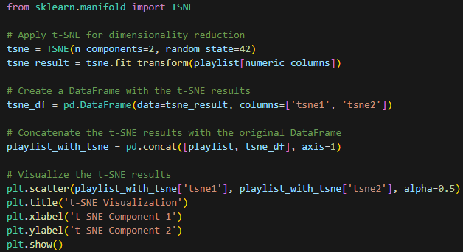
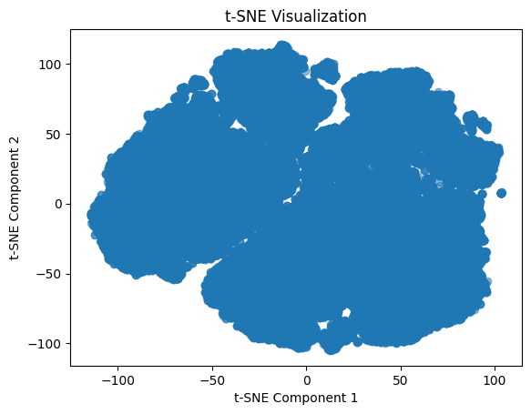
DIMENSIONALITY REDUCTION USING t-SNE (t-DISTRIBUTED STOCHASTIC DISTRIBUTION)

Slide 8
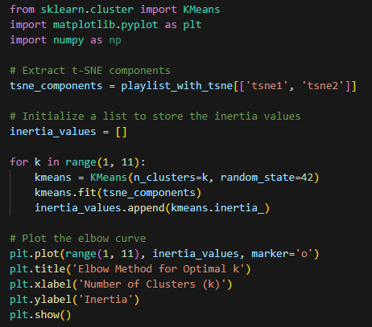
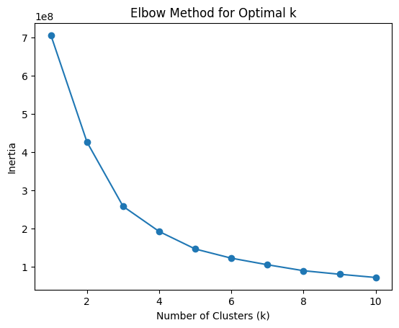
CLUSTERING USING K-MEANS ALGORITHM
(USING ELBOW METHOD TO IDENTIFY ‘K’)
In our case, we need more than 3 clusters for mood labels. Hence, we’re taking 6 clusters

Slide 9
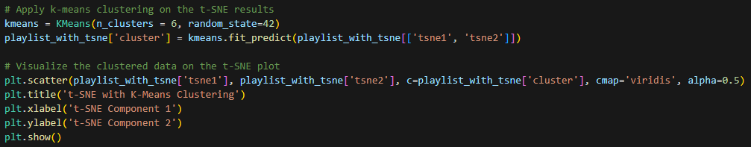
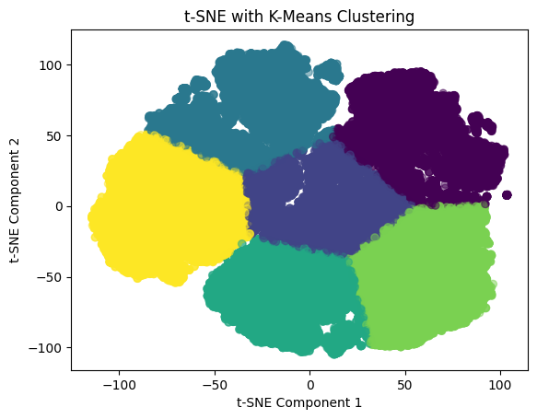
CLUSTERING USING K-MEANS ALGORITHM
(VISUALIZING THE 6 CLUSTERS)

Slide 10
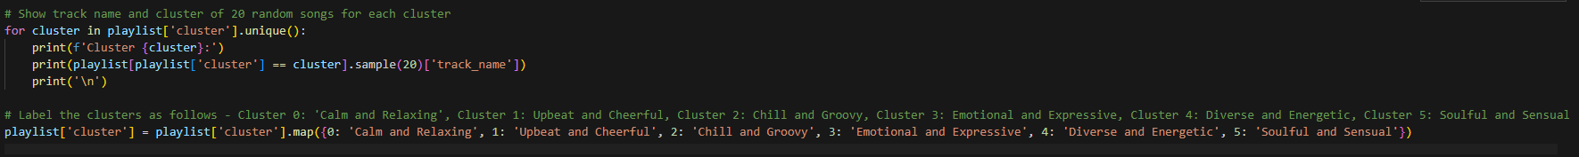
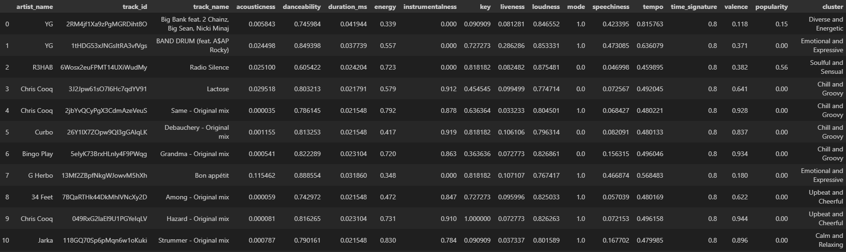
ANALYZING CLUSTERS AND CREATING MANUAL MOOD LABELS

Slide 11
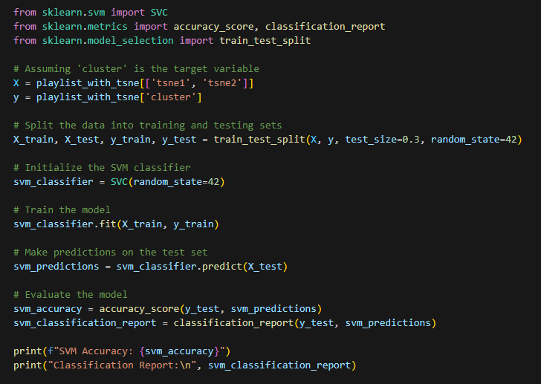
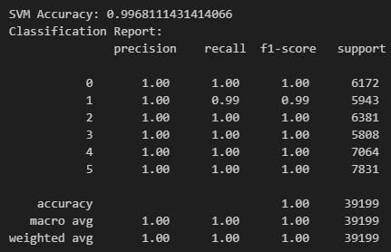

TRAINING SIMPLE VECTOR CLASSIFIER ON LABELLED DATA

Slide 12
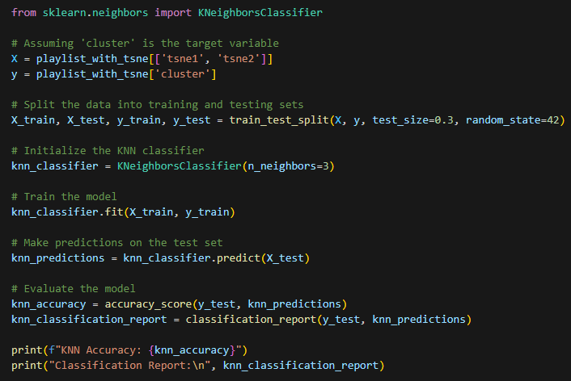
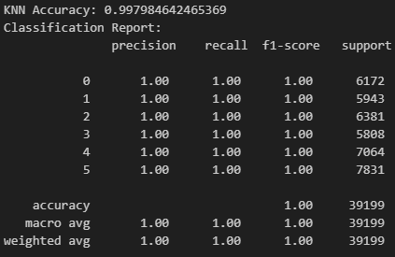

TRAINING K-NEAREST NEIGHBOR ON LABELLED DATA

Slide 13
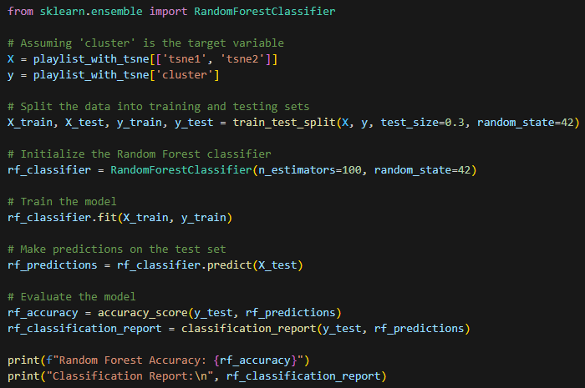
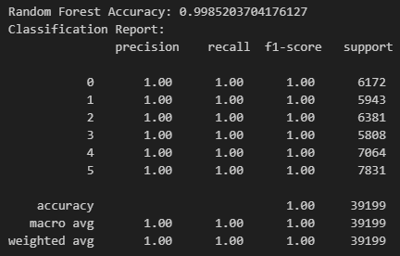

TRAINING RANDOM FOREST ON LABELLED DATA

Slide 14
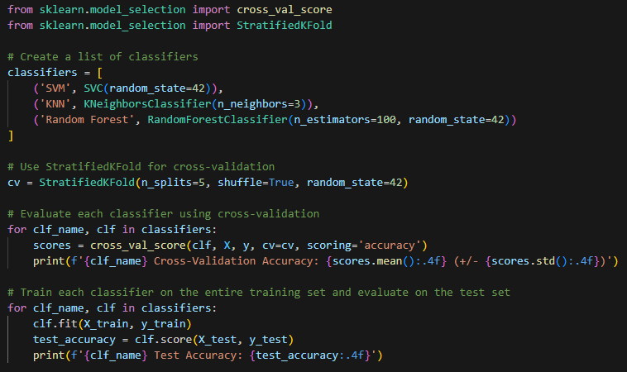
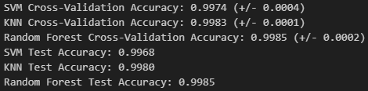
CROSS VALIDATING ALL CLASSIFIERS USING STRATIFIED K-FOLD

Slide 15
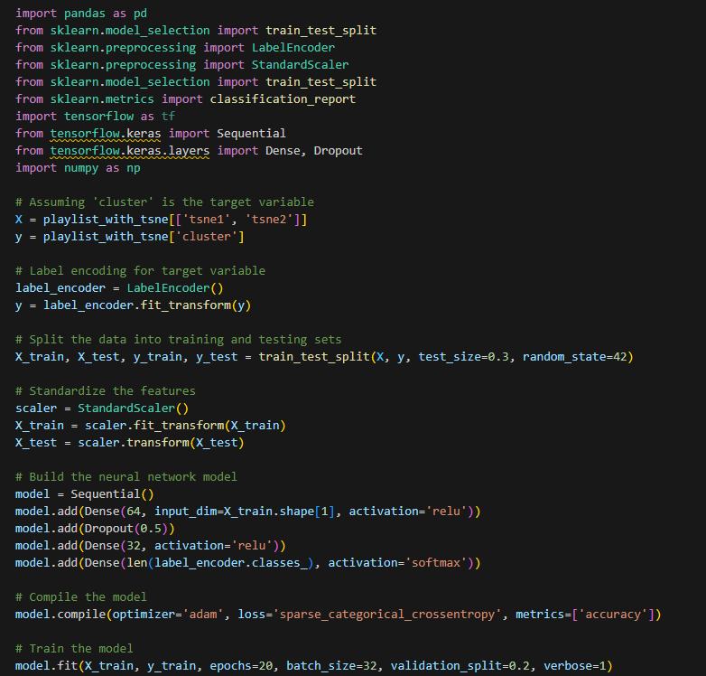
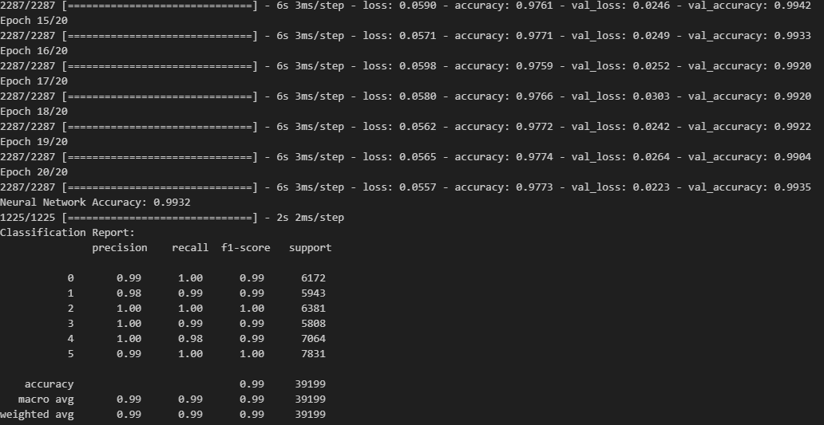
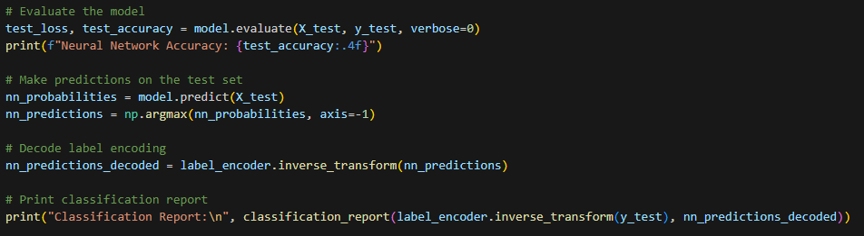
TRAINING CLASSIFIER NEURAL NETWORK

Slide 16
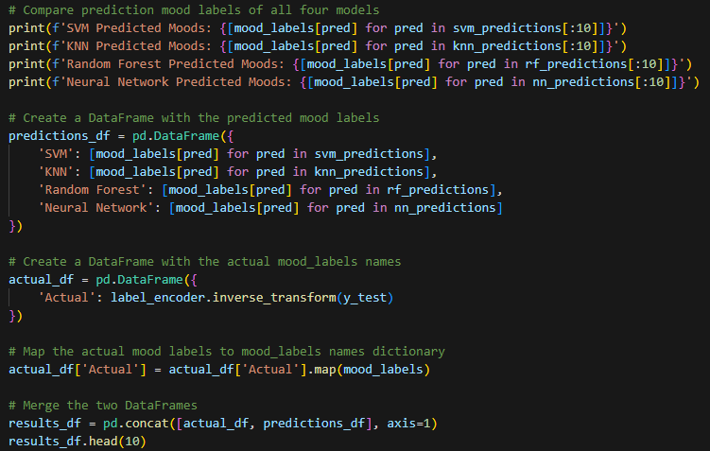
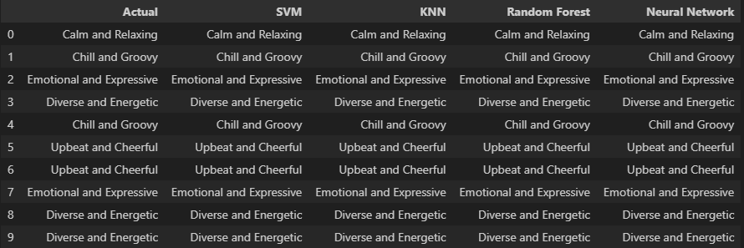
COMPARING PREDICTIONS OF ALL 4 CLASSIFIER MODELS

Slide 17
THANK YOU!

